Slide 1

The water that makes the Barley
Advocating for less water and more beer.

Slide 2
Crop change Barley
Based on reported water use (FAO) Barley requires half the irrigated water than Pistachios.
ET from Barley ( 0.003 mm/day) vs Pistachios (0.006 mm/day)
Required pumping for Barley is 2250 cubic meters per day vs 4500 for Pistachios
Plus, you can use it to make beer!

Slide 3
Well Placement
Move the well closer to river, so it draws more from river than storage; reduces impact on Aquaseca's well
Agricultural field is nearby and down gradient, so less pipeline costs

Slide 4
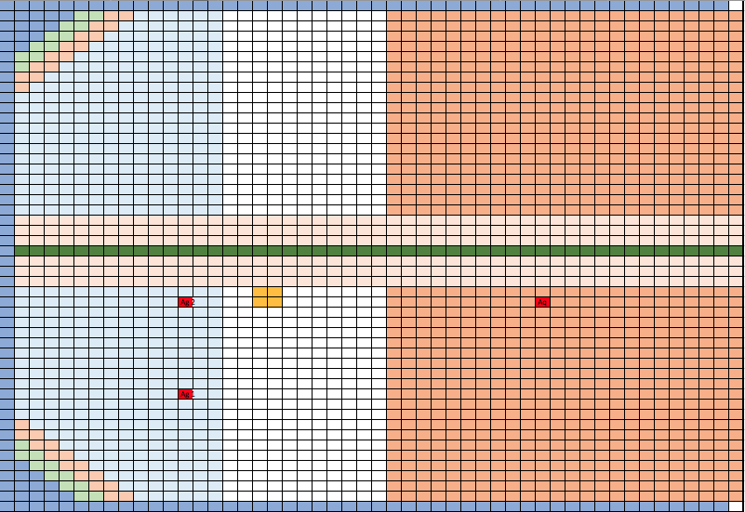
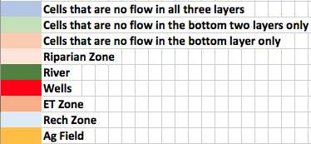
NEW WELL
OLD WELL

Slide 5
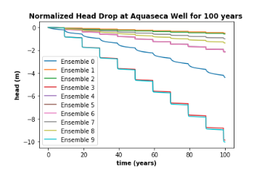
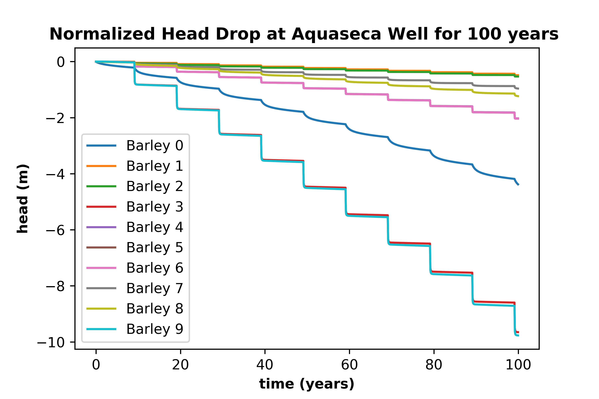
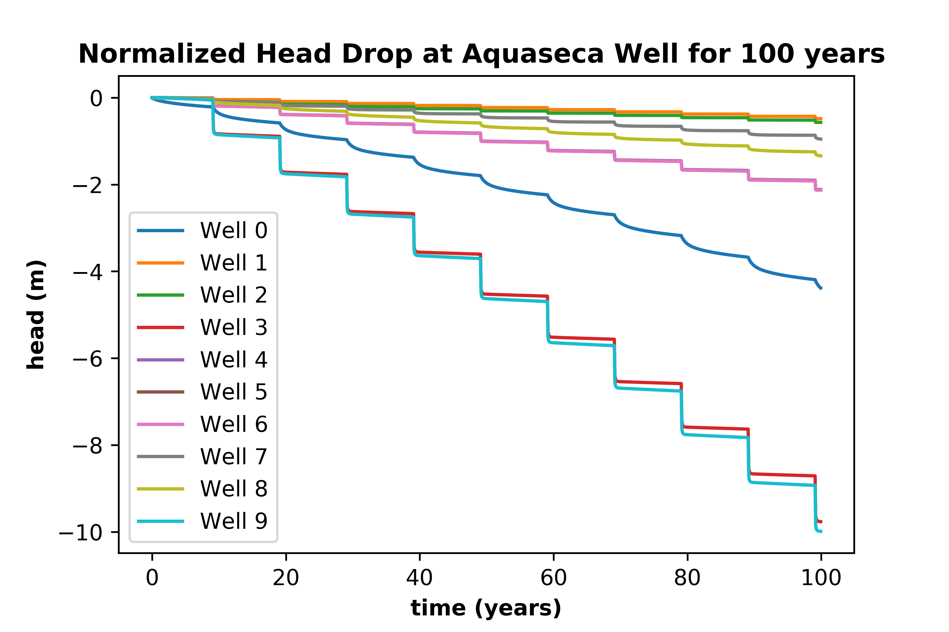
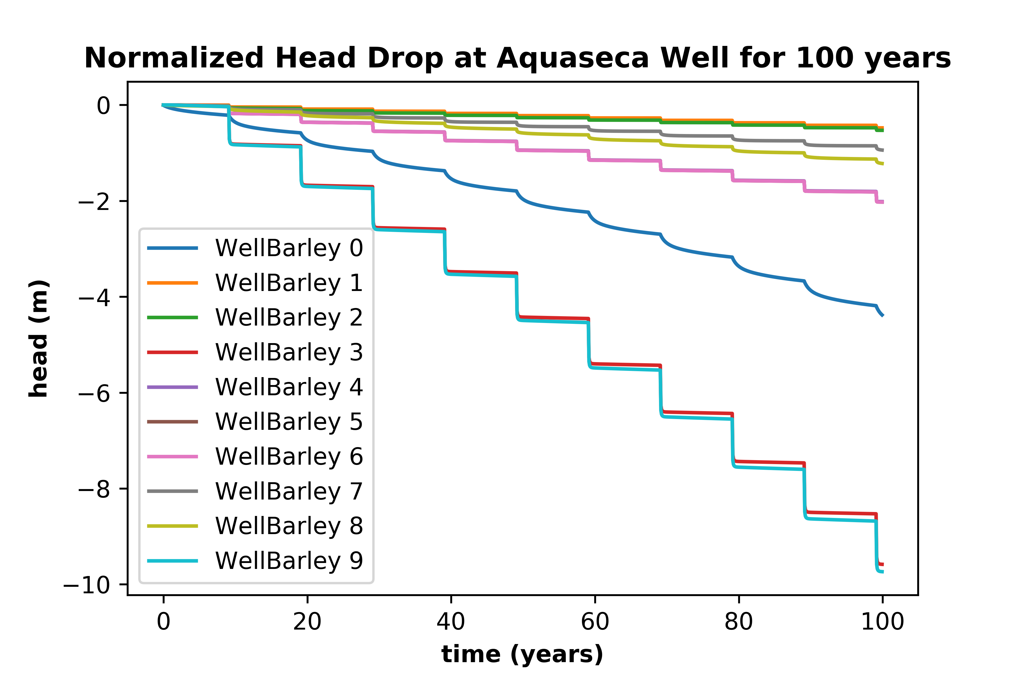

Slide 6
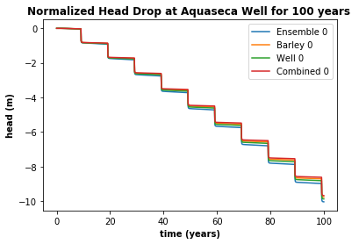
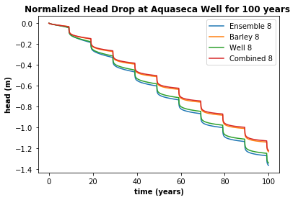
Examples of Normalized Head Plots

Slide 7
Changes in drawdown at Aquaseca well
Ensemble | Number | Initial Drawdown | Barley Drawdown | Well Move Drawdown | Both Drawdown
1333113 | 0 | -4.39 | -4.38 | -4.38 | -4.38
3133113 | 1 | -0.50 | -0.49 | -0.48 | -0.48
3111331 | 2 | -0.58 | -0.53 | -0.57 | -0.53
1111331 | 3 | -9.89 | -9.65 | -9.77 | -9.58
2121331 | 4 | -2.14 | -2.03 | -2.11 | -2.02
2121311 | 5 | -2.15 | -2.04 | -2.13 | -2.03
2122111 | 6 | -2.15 | -2.04 | -2.13 | -2.03
2213223 | 7 | -1.00 | -0.96 | -0.95 | -0.94
2211221 | 8 | -1.38 | -1.23 | -1.34 | -1.22
1111111 | 9 | -10.05 | -9.77 | -9.99 | -9.74
Notes:
Arrows indicated min and max

Slide 8
Drawdown as a percentage
Number | Barley difference (%) | Well move difference (%) | Both difference (%)
0 | 0.3 | 0.1 | 0.2
1 | 2.8 | 3.3 | 4.6
2 | 7.6 | 1.1 | 8.8
3 | 2.4 | 1.3 | 3.2
4 | 5.1 | 1.1 | 6.0
5 | 5.3 | 0.9 | 6.0
6 | 5.2 | 0.9 | 6.1
7 | 3.4 | 4.4 | 5.9
8 | 10.8 | 3.1 | 13.2
9 | 2.8 | 0.6 | 3.2
Average | 4.6 | 1.8 | 5.7
Notes:
Arrows indicate min and max

Slide 9
 | Storage Changes
 | Ensemble | Number | 100 Year Barley Crop change from Proposal | 100 year Well Move Change from Proposal | 100 year Well+Barley Change from Proposal
Min % Change | 1333113 | 0 | 36.2% | 39.9% | 57.1%
Min Head Change | 3133113 | 1 | 39.0% | 45.9% | 62.4%
Max % Change | 2211221 | 8 | 40.4% | 2.7% | 41.8%
Max Head Change | 1111111 | 9 | 39.1% | 5.1% | 41.1%

Slide 10
 | Stream Leakage
 | Ensemble | Number | Barley vs Pistachio Difference | Well Move vs Proposal | Combined Diff from Proposal
Min % Change | 1333113 | 0 | -2.97% | 10.13% | -1.58%
Min Head Change | 3133113 | 1 | -3.91% | 0.28% | 0.99%
Max % Change | 2211221 | 8 | -2.12% | 0.31% | -1.94%
Max Head Change | 1111111 | 9 | -7.58% | 6.79% | -3.41%
 | Average Change: |  | -4.14% | 4.38% | -1.48%
Notes:
Estimated errors for ensembles 0 and 1 are 5.5 to 6.5%
Estimated errors for ensmembles 8 and 9 are <0.5% and <0.05%

Slide 11
Model performance
Ensemble | Number | Damp value
1333113 | 0 | 0.01
3133113 | 1 | 0.01
3111331 | 2 | 0.1
1111331 | 3 | 0.9
2121331 | 4 | 0.5
2121311 | 5 | 0.9
2122111 | 6 | 0.5
2213223 | 7 | 0.1
2211221 | 8 | 0.5
1111111 | 9 | 0.9
The damp
Affected the quality of the solution
Varied based on which parameter had high values in the ensemble
Sensitive to K and Sy
Outputs every timestep
Decreased efficiency

Slide 12
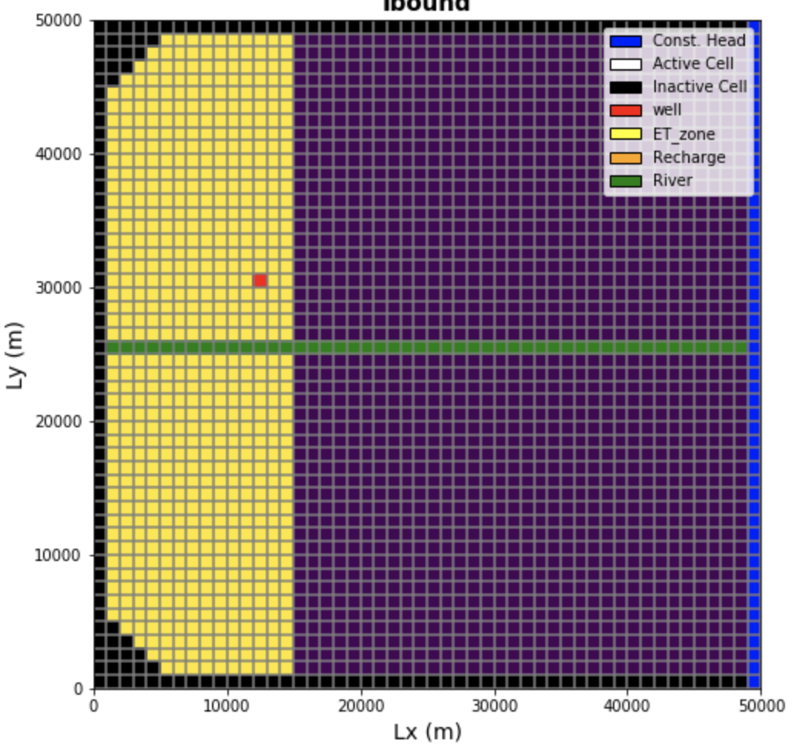
Honorable Mentions
Alternative ag well placement
Location of farm
Pros:
Less effect on town well
Cons:
Cost of delivery
Permitting
Further from ag field
Conclusion – keep well on same side of river
Pros:
Less effect on town’s well
Cons:
GroMore complaints
Aquaseca more concerned with the ag well
Conclusion – don’t move it
Notes:
The location of the irrigation well. But, the ag interest will fight it if the well is farther from the farm than in the proposed plan. (They are concerned about permitting and cost of delivery.)
The crop. But, the ag interest will not be happy about being restricted to a potentially lower value crop.
The location of the farm. But, the ag interest has worked out a pretty good deal for the land, so they will resist this, too.
a summary of the alternate designs you considered and why you didn't select them

Slide 13

Recommendations
Crop change and well move
Less impact on Aquaseca well
Water delivery cost decreases
Future growth and increased pumping possible
Beer

